Slide 1

A Convolutional Network For Detecting Visual Texture
Wednesday, 8 June 2022
Conrad Scherb, BE (Mechatronics) conjoint BSc (Physiology)
Callan Loomes, BE (Mechatronics) conjoint BSc (Physiology)
Notes:
Introduce ourselves, including how we both have a conjoint in physiology. Introduce that our project is physiology related.

Slide 2
Project/Presentation Overview
What is visual texture, how do we detect it?
Modelling the Brain
How our Models Performed
Biological and Technological Implications
Notes:
Callan. Basically an abstract going over what the project is about, and roughly what we are going to cover in the presentation

Slide 3

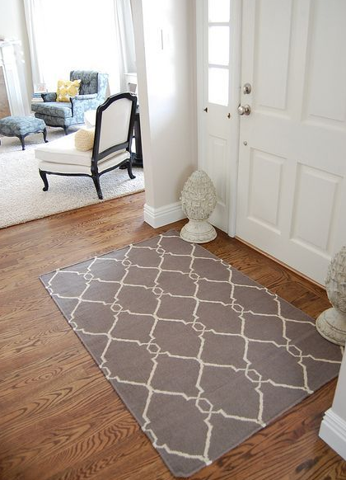
An Introduction to Visual Texture
Object boundaries are a function of both luminescence and texture
Texture is an attribute describing a surface’s unit “alignment”
In this example, the boundary between the doormat and floor is primarily defined by texture
Figure 1: Example of everyday textures
Notes:
Callan: Explain that object boundaries (ie, between two different objects or surfaces) are due to luminescence differences (eg color and brightness) and also differences in texture. Texture is a property of a surface which describes how its units are arranged.

Slide 4
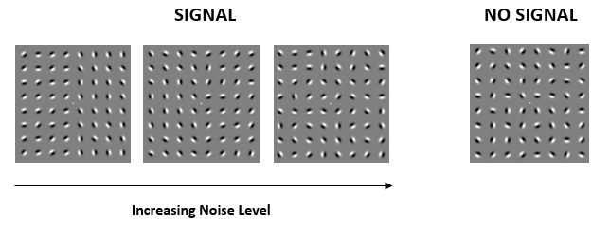
Using Gabor Patches to Represent Texture
In this research project, we simplify and control texture boundaries in using a series of Gabor patches with a random noisy orientation
Series of 8x8 Gabor patches generated. In 50% of data, vertical texture pattern (signal) is added with varied amount of noise
Figure 2: Example gabor patch arrays showing increasing noise in signal and no signal images
Notes:
Callan: Talk through how we have modelled texture in this project using Gabor patches. This allows us to simply the process of texture recognition and analysis into something we can control.

Slide 5

Which Images Contain a Texture?
Notes:
Callan: Thought experiment with audience, ask whether there is a signal, pause, then give answer (not asking for hands up etc, but giving a moment for audience to think about it). This image clearly contains a signal with minimal noise.

Slide 6

Which Images Contain a Texture?
Notes:
Callan: This image does not contain a signal, and is pure noise

Slide 7

Which Images Contain a Texture?
Notes:
Callan: This image contains a single, but also a lot of noise. We want to know why and how a human detects a signal within the noise.

Slide 8
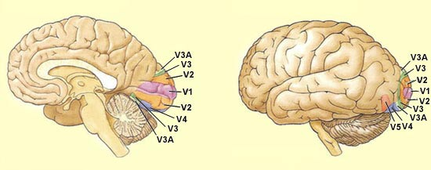
What we Know About the Brain
Visual information is processed in different areas of the brain.
Visual information processed with hierarchical structure.
Low level orientation and texture segregation occurs in the V1 layer
Figure 3: Diagram showing the layered structure of the visual cortex (Dubuc, 2002)
Notes:
Conrad: Describe the general structure of the visual cortex, and how we process visual information in layers. Highlight the primary visual cortex as the area we are trying to study in this paper

Slide 9
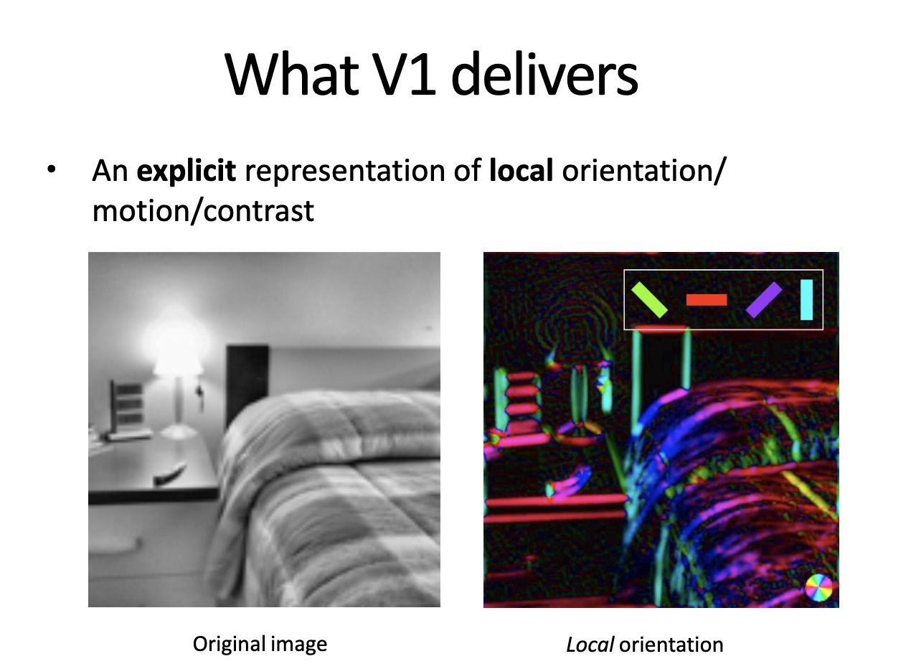
The Primary Visual Cortex (V1)
ORIGINAL IMAGE
Focused on orientation and spatial frequency of stimuli (texture)
Quick response, generally separated from higher level thinking processes
V1 itself has a layered structure which is akin to a multilayered CNN
V1 RECREATION
Figure 4: Representation of how V1 layer views an image (Dakin, S 2020).
Notes:
Conrad: Describe more detail about the primary visual cortex, and go into detail about how it separates orientation and spatial frequency from images. This basically leads to the detection of texture boundaries

Slide 10

Collecting Data from Users
Observer determines whether or not a signal (vertical boundary) is present, or if image is just noise
Quickly flash data to isolate human V1 response
80% of data is used for training, 20% used for validation
Figure 5: Gif showing how user data was recorded
Notes:
Conrad: Quick description of how we collected data with flashing images, and indicate this is to try and isolate the V1 layer. Briefly mention our training/validation split

Slide 11
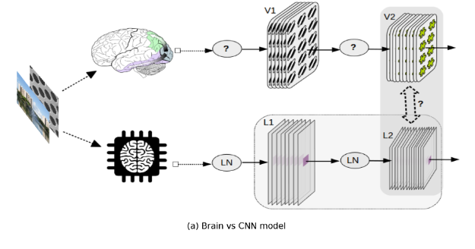
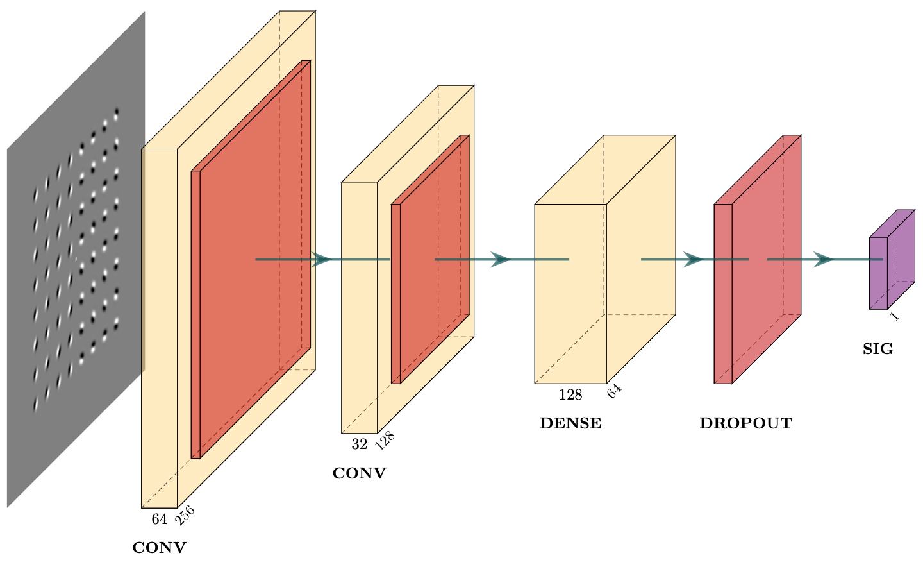
Modelling The Brain with CNNs
Convolutional neural networks used to model the V1 cortex
Models trained on both “ground truth” and “user validated” data
Base model generated based on existing papers (Laskar et al., 2020). Adapted this model to better suit our data.
Figure 6: Laskar et al. (2020) use CNNs to model the V2 layer of the visual cortex.
Figure 7: Base CNN model generated for modelling V1 layer
Notes:
Conrad: Mention the principle of using CNNs to model the primary visual cortex. Talk through how ground truth trained models were used to compare the human and “ideal machine” responses, and how user trained models were used to try generate a model that represents a human as much as possible. Then talk about how we started from a model highlighted in previous papers and adapted it with dropout layers, data augmentation etc to better suit our purpose and reduce overfitting.

Slide 12
Which Model is Best?
Want to create a CNN which resembles human response
Experiment with structure:
How many convolutional layers?
Number of Neurons in each layer?
What type of activation layers?
Notes:
Callan: Talking here about how we are adapting the user trained model to try and get higher and higher accuracy, and hence something that matches a human’s response as close as possible. Therefore we can determine the structure of the V1 layer through backwards deductive reasoning.

Slide 13
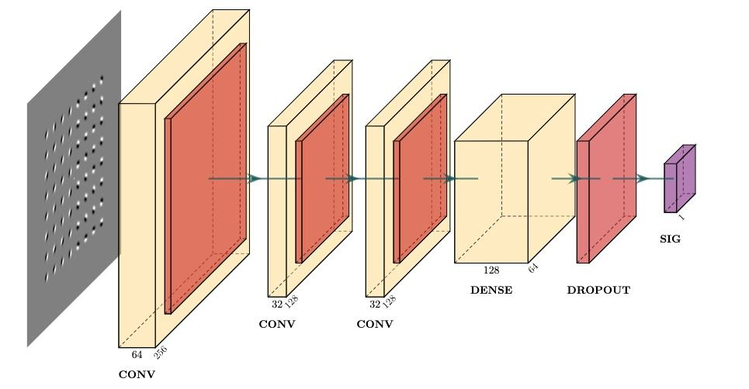
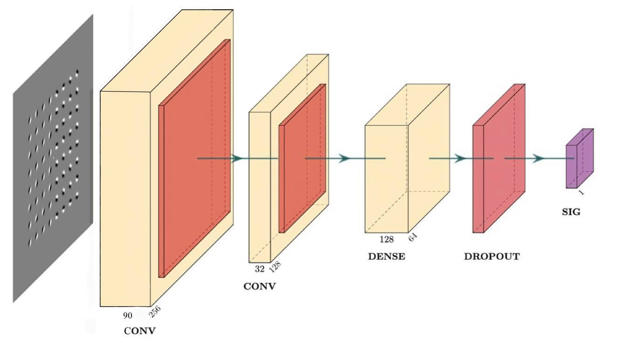
Modifying the Base Structure
Adding convolutional layers
Adding neurons in first layer
Notes:
Callan: Putting the last slide into context, showing how the structure of the model changes when we add/remove convolutional layers or neurons.

Slide 14
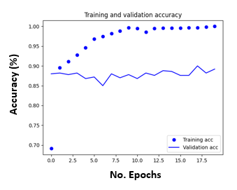
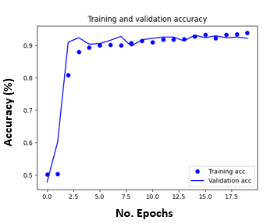
Performance of Base Models
Initially, base model had issues with overfitting.
Adding dropout layers and data augmentation to prevent overfitting.
New model has less overfitting, and hence higher accuracy on unseen datasets.
Figure 7: Accuracy of base model before improvements
Figure 9: Accuracy of base model after improvements
Notes:
Conrad: Here we introduce overfitting and why it is a problem. We then briefly talk about some modifications we made. This won’t be too interesting to the audience, and the main focus of this slide is to introduce overfitting and why it is bad for the future slides.

Slide 15
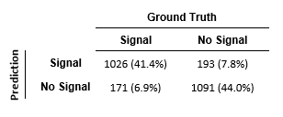

Human Vs CNN Performance
Human performance has an 85.4% accuracy correctly detecting a signal.
CNN model trained on ground truth data has an accuracy of 94.8% in detecting signal.
USER
CNN
Figure 10: Tables comparing performance of human (left) and trained CNN model (right) on detecting a signal in texture image.
Notes:
Conrad: Describing the performance of the improved base model trained on ground truth data. Mentioning that it has higher accuracy than a human in recognising signal. This indicates that there is a noise point where humans can’t detect signal, and perhaps alludes to the simplicity of human processing. Also mention here basic human error, reaction time etc that may also be the cause of this result.

Slide 16
User Trained Models
Many models generated with different structures, all trained using user data as the “truth”
Attempting to get a model with high accuracy, meaning it mimics a human response
Accuracy at plateau after 20 epochs recorded to measure effectiveness of model.
Notes:
Callan: Brief slide to introduce the next two slides. Mentioning how we trained the models on user data to try mimic a human V1 response, and which changes we made. Also mentioning how plateau accuracy was used to compare the models.

Slide 17
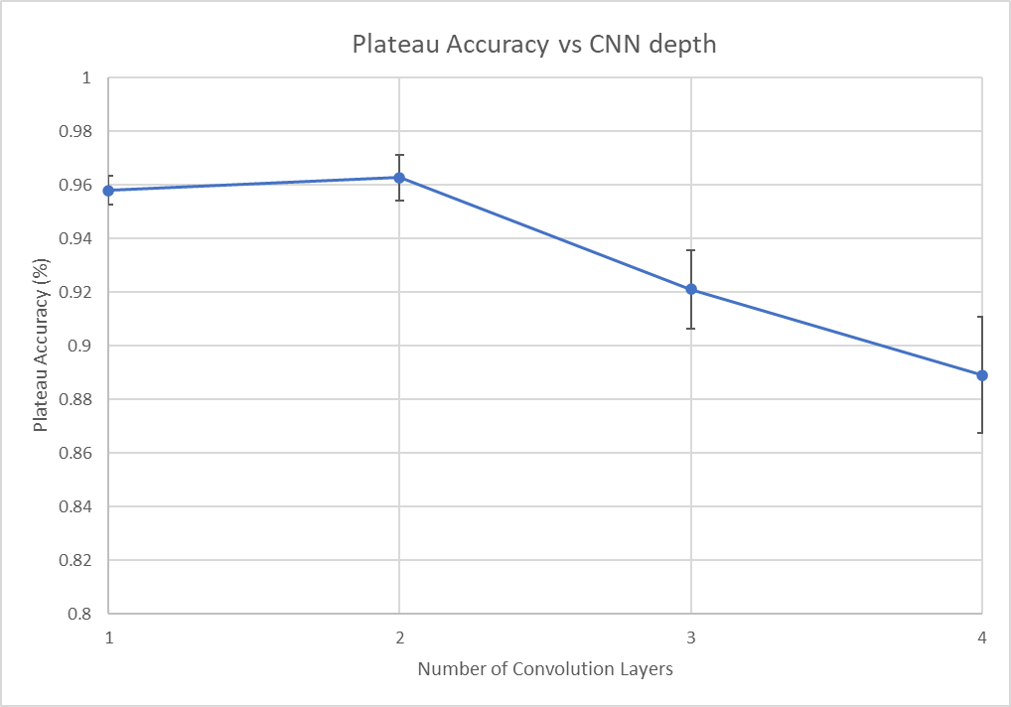
Figure 11: Graph of CNN plateau accuracy after 20 epochs of training vs the number of convolutional layers in the model. Error bars represent 1 STD.
Notes:
Conrad: Talking through CNN depth, and how it appears that when models get too “deep”, we see a drop off in accuracy. This likely mimics the simple structure of the primary visual cortex. (Could mention here that there is a peak at two that is due to the presence of simple and complex connected with interneurons cells which are similar to a two layer structure).

Slide 18
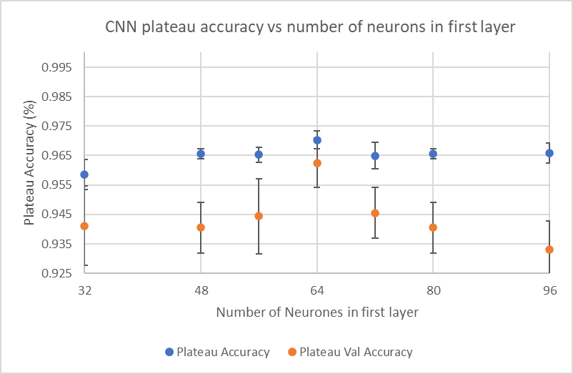
Figure 12: Graph of CNN plateau accuracy after 20 epochs of training vs the number neurons in the first layer of the model. Error bars represent 1 STD.
Notes:
Callan: Now talking about how the number of

Slide 19
Summary So Far
Humans are typically less accurate than machines for detecting base visual texture.
Human response may be better mimicked by more shallow CNNs (Kociolek et al., 2022)
The ideal number of neurons may be equivalent to the complexity
We want to experiment further with other structures
Notes:
Callan: Here we just summarise everything we have presented. Will be careful to use terms like “possible” to avoid any preemptive conclusion. Will also talk briefly about where the rest of the project will lead us. Will mention the Koviolek paper which supports our current data.

Slide 20
References
Dakin, S. (2020). The extrastriate visual cortex. MEDSCI 316 Lecture Slides.
Dubuc, B. (2002). THE BRAIN FROM TOP TO BOTTOM. The Brain from Top to Bottom. https://thebrain.mcgill.ca/flash/i/i_02/i_02_cr/i_02_cr_vis/i_02_cr_vis.html
Kociołek, M., Kozłowski, M., & Cardone, A. (2022). A Convolutional Neural Networks-Based Approach for Texture Directionality Detection. Sensors, 22(2), 562. https://doi.org/10.3390/s22020562
Laskar, M. N. U., Sanchez Giraldo, L. G., & Schwartz, O. (2020). Deep neural networks capture texture sensitivity in V2. Journal of Vision, 20(7), 21. https://doi.org/10.1167/jov.20.7.21
Notes:
A few brief refences

Slide 21
Acknowledgements
Luke Hallum, Project Supervisor
Notes:
Concluding slide where we will settle on for questions, and also provide acknowledgments to our supervisor :)

